Slide 1



Cybersecurity university
Week-1 lecture (6/8/18)
By Tanvi shah and erika gutierrez

Slide 2
Topic overview
Fundamental Security Principles
Request Methods and Headers
Attack: URL Manipulation
Attack: Insecure Direct Object Reference (IDOR)

Slide 3
Fundamental security principles
Never Trust Users
Least Privilege
Simple is more secure
Expect the unexpected
Defense in Depth
Security through obscurity
Prefer Whitelisting over Blacklisting
Map Data Movement and Exposure

Slide 4
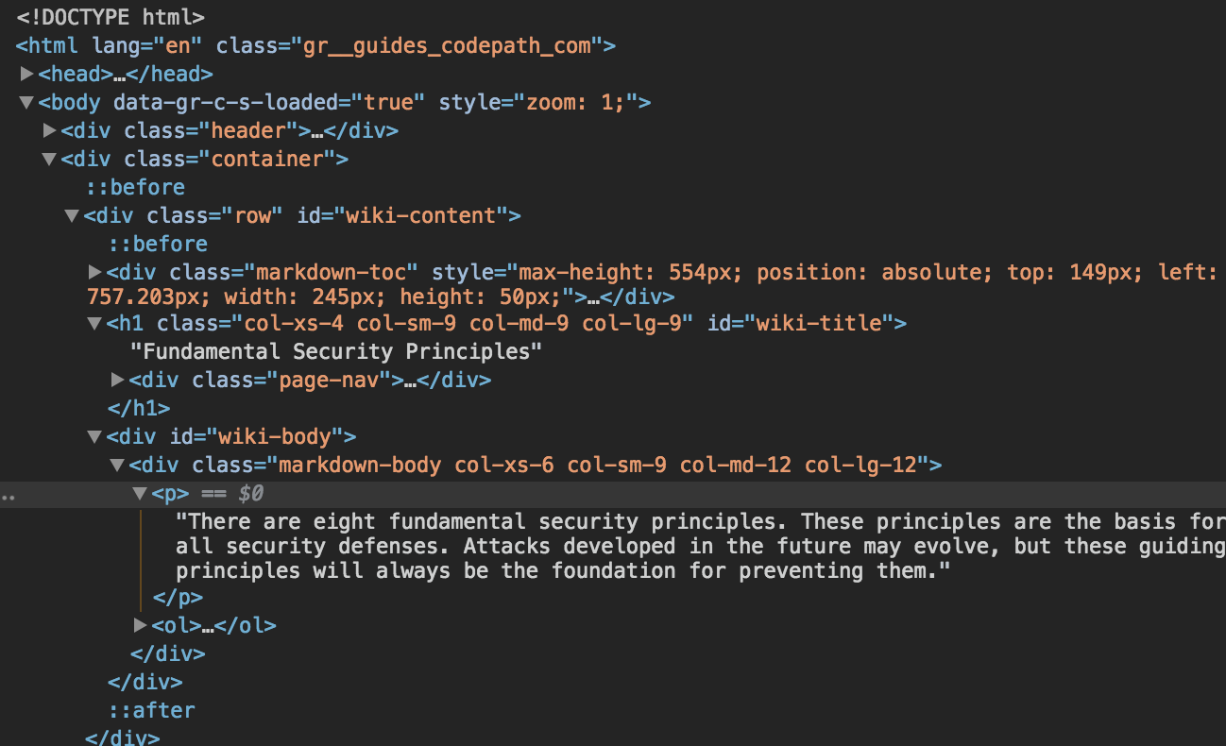
html
Hypertext Markup Language (HTML)
Foundational language of the web
Markup = special meaning to web pages
Hypertext = link text to other parts of page
Defined Syntax
Need to know the basics of HTML to be successful in this class…
https://www.codecademy.com/learn
https://www.w3schools.com/default.asp

Slide 5
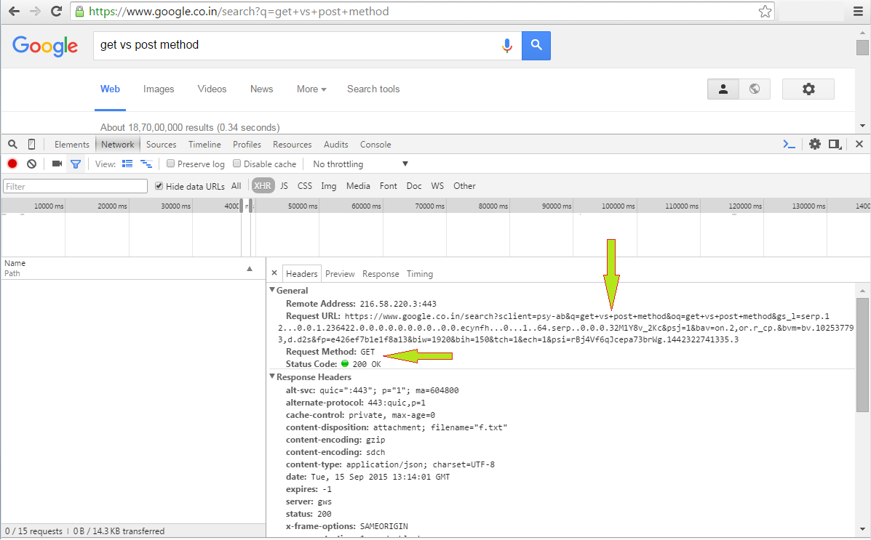
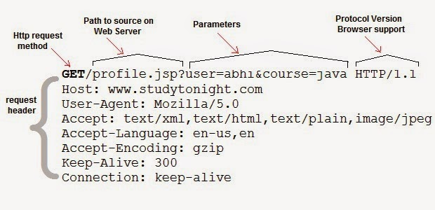
GET and post

Slide 6
Request methods and headers
GET
Sent when URL is submitted in the browser location bar or a user clicks a link
Send data in the URL and query string
Reloadable
Can bookmark
Used for read-only operations
View, search, sort, or filter data
Data does not change
POST
Sent when web form is submitted
Send data in the URL and as an attachment
Semi-reloadable (prompt to send data again)
Can not bookmark
Used for write operations
Create, update, or delete data
Data does change

Slide 7
url manipulation
Easiest attack to perform, curious users, probing hackers
URL = request from browser to server…thus, it is vulnerable
Request A => Response B
Request easily edited
URLs often follow a pattern

Slide 8
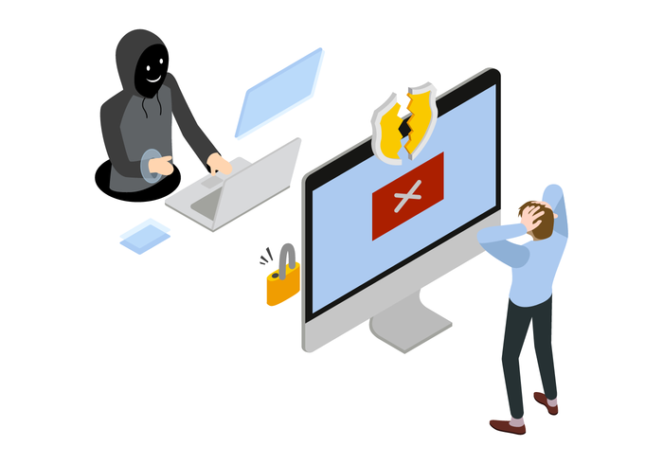
URL Manipulation
Adding or changing query parameters
Searching for new web pages
Accessing similar resources
Enumerating values in the database
Escalating access privileges
Detecting installed software
Accessing the server's file system
Trying to use values for remote code execution

Slide 9


URL Manipulation
Adding or changing query parameters
Searching for new web pages
Accessing similar resources
Enumerating values in the database
Escalating access privileges
Detecting installed software
Accessing the server's file system
Trying to use values for remote code execution

Slide 10
URL Manipulation Preventions
Never consider a URL to be private
Not linking to a URL does not mean it will not be found
Use access controls to restrict access, not URL visibility
Every URL should enforce proper limits
Consider edge cases and expect unexpected
Every URL should have robust error handling
Configure web server to gracefully handle errors and unfound URLs

Slide 11
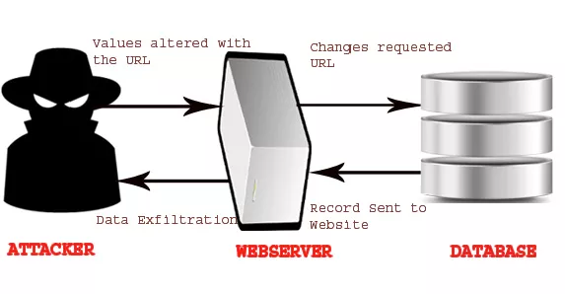
Insecure direct object reference (IDOR)
IDOR is when code accesses a restricted resource based on user input, but fails to verify user's authorization to access that resource
There exists a "direct reference" to an "object" which is "insecure"
Examples of types resources which could have IDOR are:
Database data
Files
Directories
Scripts
Functions
If a user can trigger what should be a privileged result without having to validate their privileges, then it is probably a case of IDOR

Slide 12

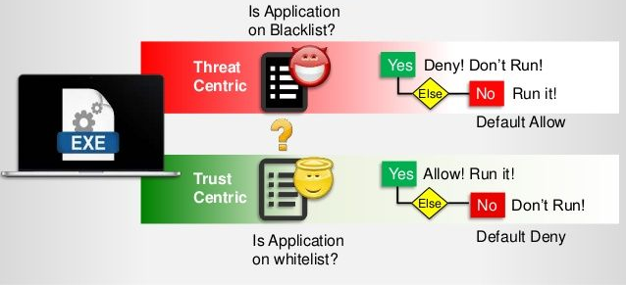
IDOR preventions
Validate a user’s authorization before allowing access to a privileged resource
Whitelisting

Slide 13

Questions/CoMMENTS?

